Slide 1




PS05 — AI Innovation for Public Services & Citizen-Centric Governance
JANSEVA-X
From citizen intent to completed government application.
Intent
Consent
Completion
Intent-first. Consent-based. Officer-controlled.

Slide 2


THE HUMAN PROBLEM
The citizen should not have to
learn the system before using it.
Citizens hunt for portals, interpret requirements, gather documents, then enter the same data repeatedly.
01
Deadlines become pressure.
Urgency rises when the next step is unclear.
02
Repeated fields create frustration.
Document hunting slows everything down.
03
Queues add uncertainty.
The burden is not just paperwork.
It is uncertainty at every step.
Without clear status, citizens are left waiting and wondering.
A fragmented journey turns a simple public service into a test of patience.

Slide 3



THE SOLUTION
Tell JANSEVA-X what you need.
An intent-first journey that routes citizens to the right service while keeping consent visible.
01 · UNDERSTAND
02 · PREPARE
03 · COMPLETE
Start with intent
Prepare with consent
Complete with clarity
Citizens explain what they need in their own words, by voice or text.
Smart Fill prepares ready-to-review fields. Smart Attach aligns required documents.
Submit, track and move through a clear officer-owned application lifecycle.
•Service discovery made simple
•Consent stays visible and explicit
•Status stays easy to follow
•Guided routing to the right service
•Smart Fill + Smart Attach reduce gaps
•Every request has an owner

Slide 4
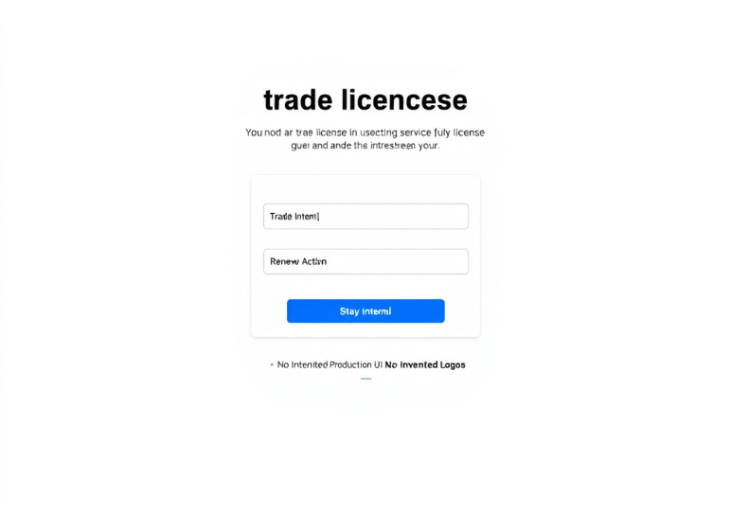
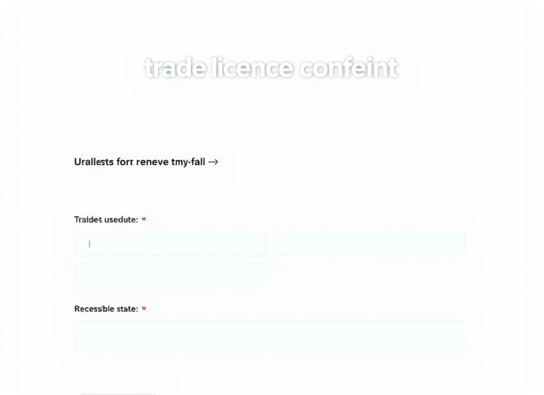
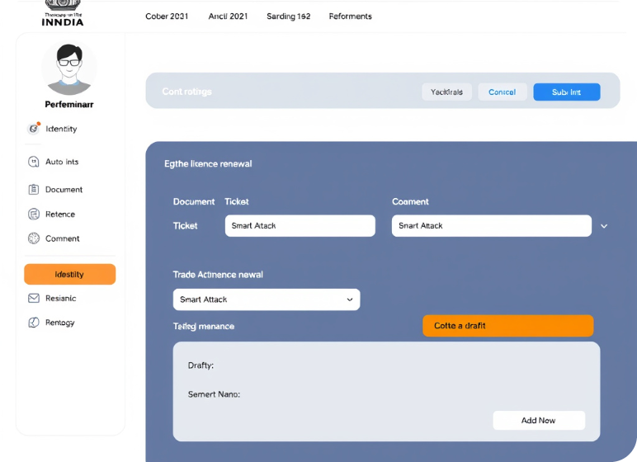





LIVE PROTOTYPE · TRADE LICENCE RENEWAL
A complete guided Trade Licence Renewal journey.
Intent, consent and smart preparation lead to mock verification, ticket tracking and an informed draft/submit choice.
The application, unfolding step by step
Citizen-led journey
Guidance with clear boundaries.
Consent boundary
Preparation begins only after explicit citizen consent.
Smart Fill + Attach
Ready-to-review fields and required documents using synthetic demo data.
Identity + tracking
01 · Intent
02 · Assist
03 · Complete
Mock verification, ticket reference and clear application status.
Start with the service the citizen came for.
Consent unlocks Smart Fill + Smart Attach.
Verify identity, get a ticket, then submit or save draft.
Prototype only — no real registry retrieval or government data access.

Slide 5

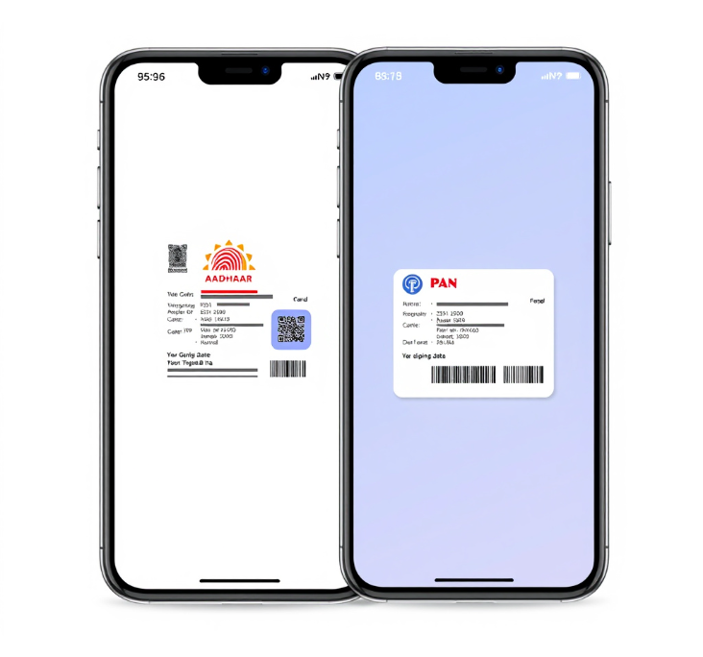
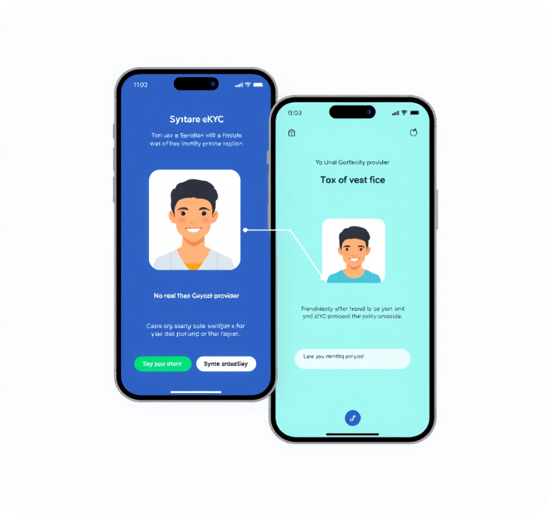
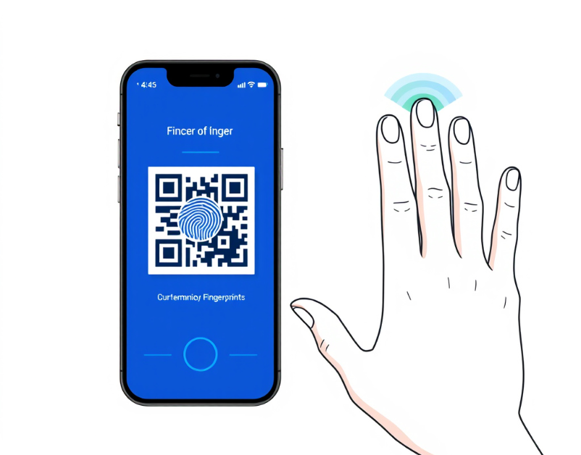




PROTOTYPE VERIFICATION
Verification is visible, deterministic and clearly marked as a prototype.
A guided synthetic journey — from document capture to face and biometric demos.
Prototype sequence
Demo state
Synthetic-only by design.
The prototype makes its verification boundary impossible to miss.
Mock documents and demo biometrics only
No real government provider is contacted
03 QR fingerprint + five-finger scan
01 Mock Aadhaar + mock PAN
02 Mock e-KYC + face demo
Safe to present, inspect and repeat.
Every state is visible before the next step begins.

Slide 6




HUMAN-OWNED REVIEW
AI assists the officer. The officer owns the final decision.
One shared application state keeps citizen progress and officer action aligned from intent to completion.
1
2
3
Submission enters the queue
Officer claims and reviews
AI advises. Officer decides.
Citizen submission and evidence arrive in one shared case state.
The officer reviews evidence, identity signals and application context.
Approve, correct, or reject remain officer decisions.
Approve Correct Reject
Shared lifecycle state connects citizen progress, evidence and officer action.

Slide 7
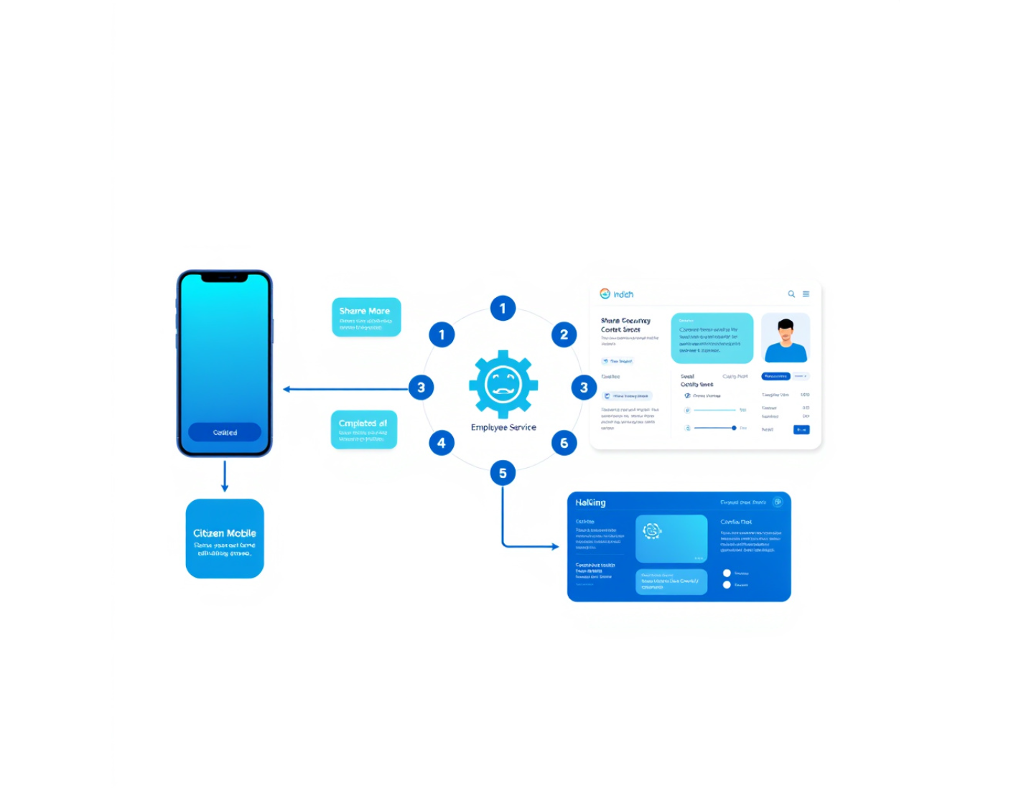



SYSTEM ARCHITECTURE
How it is built
Two service journeys, one shared foundation — designed for citizen trust and officer ownership.
One foundation, two experiences
The architecture keeps complexity behind the scenes.
Citizen frontend + backend
A guided public-service journey from intent to completion.
Shared state layer
PostgreSQL + Prisma keep every handoff consistent.
Employee frontend + backend
JANSEVA AI, mock verification, and PWA-ready workflows.
Trust moves with the case — from citizen consent to employee action.

Slide 8






TRUST, SECURITY & CONTROLLED STATES
Built around consent, ownership and controlled lifecycle states.
Every request is checked at the point of access, action and transition.
Identity & authority
State & boundary controls
The right actor, with the right permission.
Safe transitions, isolated execution.
JWT authentication
Lifecycle validation
Reject unauthenticated requests and inactive accounts.
Allow only valid, controlled state transitions.
Idempotency + isolation
Role + ownership validation
Protect documents and isolate mock-provider behavior.
Confirm role authorization and resource ownership.
Control is explicit at every trust boundary.
Consent → verify → own → transition

Slide 9







IMPACT & SCALE
A reusable layer for clearer, more guided service journeys.
One service foundation that guides citizens today and expands across government workflows tomorrow.
1
2
3
For citizens
For government
Future roadmap
Less friction
Structured review
More services
Clearer status from intent through completion.
Advisory AI supports review while officers retain ownership.
A reusable layer designed to extend beyond one journey.
Current prototype
Synthetic and mocked — a foundation for validation, not a deployment claim.

Slide 10

JANSEVA-X
Government services should understand citizens.
Tell JANSEVA-X what you need. We will help you get it done.
A GUIDED APPLICATION JOURNEY
Hackathon prototype · Public service innovation

